Slide 1
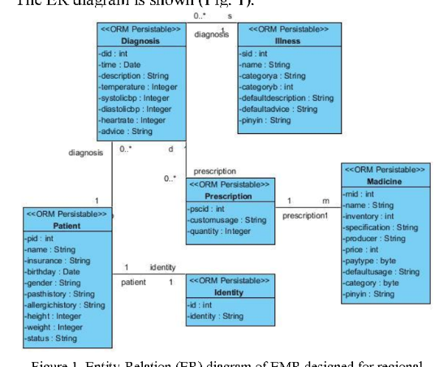
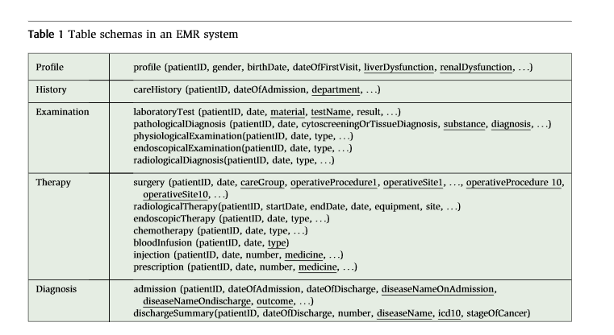
OpenEMR Reports
Demographics
openemr_MedicalProblems
Title
Coding
BeginDate
EndDate
Occurrence
ReferredBy
Outcome
Destination
AdmissionsCorePopulatedTable
PatientID
AdmissionID
AdmissionStartDate
AdmissionEndDate
Name
ExternalID
DOB
Sex
SS
License
MaritalStatus
UserDefined
BillingNote
Address
City
State
PostalCode
Country
MotherName
EmergencyContact
EmergencyPhone
HomePhone
WorkPhone
MobilePhone
ContactEmail
TrustedEmail
Provider
Referring_Provider
Pharmacy
HIPPANoticeReceived
AllowVoiceMessage
LeaveMessageWith
AllowMailMessage
AllowSMS
AllowEmail
AllowImmunizationRegistryUse
AllowImmunizationInfoSharing
AllowHeartInformationExchange
AllowPatientPortal
CareTeam
CMSPortalLogin
ImmunizationRegistryStatus
ImmunizationRegistryStatusEffectiveDate
PublicityCode
PublicityCodeEffectiveDate
ProtectionIndicator
ProtectionIndicatorEffectiveDate
Language
Race
Ethnicity
FamilySize
FinancialReviewDate
Homeless
MonthlyIncome
Interpreter
MigrantSeasonal
VFC
Religion
DateDecreased
ReasonDecreased
PatientCorePopulatedTable
PatientID
PatientGender
PatientDateOfBirth
PatientRace
PatientMaritalStatus
PatientLanguage
PatientPopulationPercentageBelowPoverty
PatientName
tblPatient
PatientID
PatientMRNNo
PatientName
DateOfBirth
Age
Gender
SymptomsAndSigns
ClinicalHistory
PhysicalExam
ECG
NTproBNP
BNP
LVEF
LAVI
LVMI
Ee
eSeptal
LongitudinalStrain
TRV
EncounterDate
LabsCorePopulatedTable
PatientID
AdmissionID
LabName
LabValue
LabUnits
LabDateTime
openemr_Prescriptions
PatientId
PatientName
Add
EndDate
Occurrence
ReferredBy
Outcome
Destination
AdmissionsDiagnosesCorePopulatedTable
PatientID
AdmissionID
PrimaryDiagnosisCode
PrimaryDiagnosisDescription
Krsiloemr
EMRBOTS.org
https://www.researchgate.net/publication/224101596_MedTAKMI-CDI_Interactive_knowledge_discovery_for_clinical_decision_intelligence
https://www.semanticscholar.org/paper/Design-a-novel-electronic-medical-record-system-for-Pan-Fu/f38d8a1a5468e1501a124766fc3b48119628f72d/figure/0

Slide 2
Patient
Diagnosis
Illness
Medicine
pid
name
insurance
birthday
gender
pasthistory
allergichistoy
height
weight
status
did
time
description
temperature
systoilicbp
diastolicbp
heartrate
advice
sid
name
categorya
categoryb
defaultdescription
defaultadvice
pinyin
mid
name
invetory
specification
producer
price
paytype
defaultusage
category
pinin
Prescription
Identity
pscid
customusage
quantity
id
identity
https://www.semanticscholar.org/paper/Design-a-novel-electronic-medical-record-system-for-Pan-Fu/f38d8a1a5468e1501a124766fc3b48119628f72d/figure/0

Slide 3
CareHistory
Examination (laboratoryTest)
patientID
DateOfAdmissioin
department
patientID
date
material
testName
result
Profile
patientID
gender
birthDate
dateOfFirstVisit
LiverDysfunction
RenalDysfunction
Therapy (surgery)
Diagnosis (admission)
patientID
date
careGroup
operativeProcedure1
operativeStie1
patientID
dateOfAdmission
dateOfDischarge
diseaseNameOnAdmission
diseaseNameOnDischarge
outcome
https://www.researchgate.net/publication/224101596_MedTAKMI-CDI_Interactive_knowledge_discovery_for_clinical_decision_intelligence

Slide 4
L.Pan EMR
MedTAKMI-CDI EMR
Patient
Diagnosis
Illness
Medicine
Profile
Therapy (surgery)
Diagnosis (admission)
pid
name
insurance
birthday
gender
pasthistory
allergichistoy
height
weight
status
did
time
description
temperature
systoilicbp
diastolicbp
heartrate
advice
sid
name
categorya
categoryb
defaultdescription
defaultadvice
pinyin
mid
name
invetory
specification
producer
price
paytype
defaultusage
category
pinin
patientID
gender
birthDate
dateOfFirstVisit
LiverDysfunction
RenalDysfunction
patientID
date
careGroup
operativeProcedure1
operativeStie1
patientID
dateOfAdmission
dateOfDischarge
diseaseNameOnAdmission
diseaseNameOnDischarge
outcome
CareHistory
laboratoryTest
patientID
DateOfAdmissioin
department
patientID
date
material
testName
result
Prescription
Identity
pscid
customusage
quantity
id
identity
Kr Silo EMR
tblPatient
PatientID
PatientMRNNo
PatientName
DateOfBirth
Age
Gender
SymptomsAndSigns
ClinicalHistory
PhysicalExam
ECG
NTproBNP
BNP
LVEF
LAVI
LVMI
Ee
eSeptal
LongitudinalStrain
TRV
EncounterDate
Notes:
<number>

Slide 5
OpenEMR Reports
EMRBOTS
Demographics
openemr_
MedicalProblems
openemr_
Prescriptions
AdmissionsCore
PopulatedTable
PatientCore
PopulatedTable
LabsCorePopulated
Table
Name
ExternalID
DOB
Sex
SS
License
MaritalStatus
UserDefined
BillingNote
Address
City
State
PostalCode
Country
MotherName
EmergencyContact
EmergencyPhone
HomePhone
WorkPhone
MobilePhone
ContactEmail
TrustedEmail
Provider
Referring_Provider
Pharmacy
HIPPANoticeReceived
AllowVoiceMessage
LeaveMessageWith
AllowMailMessage
AllowSMS
AllowEmail
Title
Coding
BeginDate
EndDate
Occurrence
ReferredBy
Outcome
Destination
PatientId
PatientName
Add
EndDate
Occurrence
ReferredBy
Outcome
Destination
PatientID
PatientGender
PatientDateOfBirth
PatientRace
PatientMaritalStatus
PatientLanguage
PatientPopulationPercentageBelowPoverty
PatientName
PatientID
PatientGender
PatientID
AdmissionID
LabName
LabValue
LabUnits
LabDateTime
PatientID
AdmissionID
AdmissionStartDate
AdmissionEndDate
AdmissionsDiagnoses
CorePopulatedTable
PatientID
AdmissionID
PrimaryDiagnosisCode
PrimaryDiagnosisDescription

Slide 6
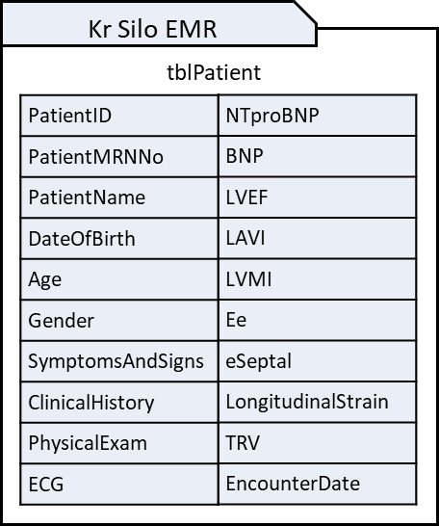
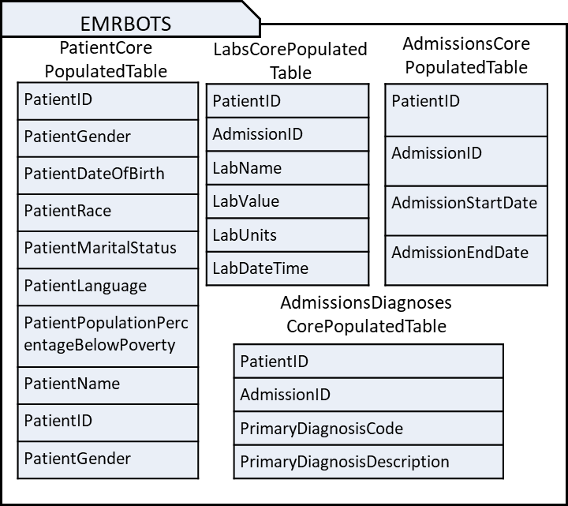
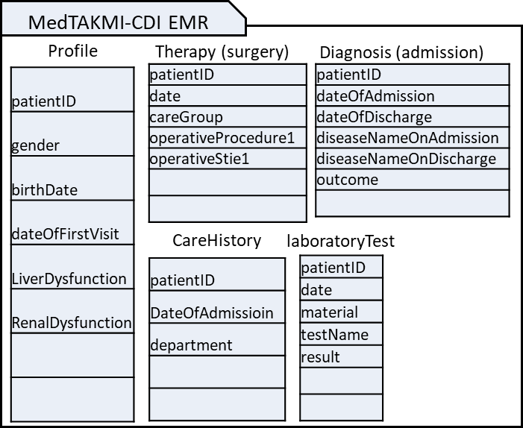
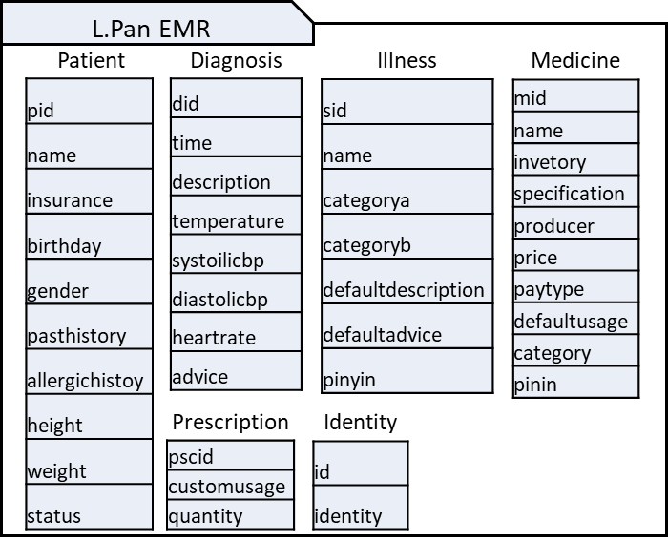
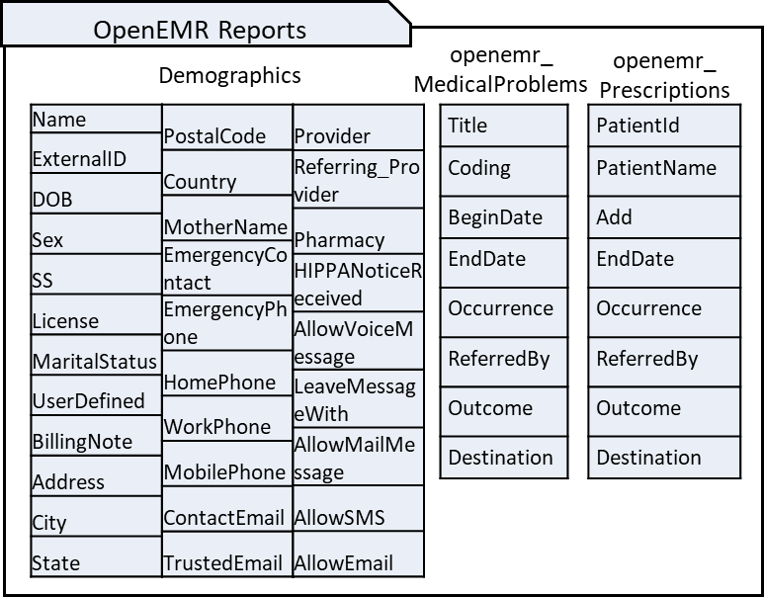
Notes:
<number>

Slide 7
s₁
s₂
s₃
s₄
s₅

Slide 8

Load schema
and data
No
Table Exist?
End
Yes
No
Attribute
Exist?
Enriched
Schema
Save Enriched
Attribute
Generate
Suffix Tree
Suffix tree
node exist ?
Get Attribute
Type from data
No
Yes
Node length
> 2 ?
No
No
Yes
Semantic Type
!= None
UMLS
Dictionary
Get node
Semantic Type
Yes
Append
Semantic Type
to Suffix Tree
Notes:
<number>

Slide 9
EMRBots.
PatientCorePopulatedTable.
PatientDateOfBirth
OpenEMR.
Demographics.
DOB
Schema 1
Schema 2
Syntactic Context Identifier
Schema Name, Table Name, Attribute Name
Syntactic Context Identifier
Schema Name, Table Name, Attribute Name
Schema: EMRBots
Table: PatientCorePopulatedTable Attribute: PatientDateOfBirth
Schema: OpenEMR
Table: Demographics
Attribute: DOB
Type Identifier
Attribute Type
Type Identifier
Attribute Type
Schema: EMRBots
Table: PatientCorePopulatedTable Attribute: PatientDateOfBirth
Type: Date(yyyy/mm/dd)
Schema: OpenEMR
Table: Demographics
Attribute: DOB
Type: Date(yyyy/mm/dd)
Semantic Identifier
Attribute semantically enriched suffix tree
Semantic Identifier
Attribute semantically enriched suffix tree
Schema: EMRBots
Table: PatientCorePopulatedTable Attribute: PatientDateOfBirth
Type: Date(yyyy/mm/dd)
Suffix Tree:
Schema: OpenEMR
Table: Demographics
Attribute: DOB
Type: Date(yyyy/mm/dd)
Suffix Tree:
Similarity Matcher
Similarity score
Similarity
Score > X
Similar
Dissimilar
Notes:
<number>

Slide 11
Attribute Context
Schema Name | Table Name | Attribute Name
Schema Version | Source | Recorded Date
Attribute Type
Data Type | Possible Value
Attribute Semantics
Suffix Tree | Suffix Concept Tree | Tree Embedding
Notes:
<number>

Slide 12
IF (True)
THEN True
Except
IF AttributeType = ‘string’
THEN False
If not
IF AttributeType = ‘integer’
THEN False
If not
IF AttributeType ⬄ ‘integer’
THEN False
Except
Except
Except
Except
IF SemanticType = ‘ST₁’
THEN ‘Concept₁’
IF SemanticType = ‘ST₂’
THEN ‘Concept₂’
IF SemanticType = ‘ST₁’
THEN ‘Concept₇’
IF SemanticType = ‘ST₁’
THEN ‘Concept₁’
Except
Except
Except
Except
Except
Except
IF SemanticType = ‘ST₃’
THEN ‘Concept₃’
IF SemanticType = ‘ST₄’
THEN ‘Concept₄’
IF SemanticType = ‘ST₅’
THEN ‘Concept₅’
IF SemanticType = ‘ST₆’
THEN ‘Concept₆’
IF SemanticType = ‘ST₇’
THEN ‘Concept₇’
IF SemanticType = ‘ST₈’
THEN ‘Concept₈’
Notes:
<number>

Slide 13
Example
IF (True)
THEN Class ‘0’
Except
IF AttributeType = ‘string’
THEN False
If not
IF AttributeType ⬄ ‘integer’
THEN False
Except
Except
Except
IF SemanticType = ‘Patient or Disabled Group’
THEN ‘Patient’
IF SemanticType = ‘Findings’
THEN False
IF SemanticType = ‘Disease’
THEN False
Except
Except
Except
Except
Except
IF = ‘Intellectual Product’ THEN ‘PatientName’
IF SemanticType = ‘Organism Attribute’
THEN ‘PatientGender’
IF Schema = ‘s1’ AND Key = ‘Diabetes’
THEN ‘0001’
IF Schema = ‘s2’ AND Key = ‘Glucose’
THEN ‘0001’
IF Schema = ‘s1’ AND Key = ‘XYZ’
THEN ‘0001’

Slide 14
Example
IF (True)
THEN Class ‘0’
Except
IF AttributeType = Integer
THEN False
If not
IF AttributeType = Categorical
THEN False
Except
Except
Except
IF SemanticType = ‘Disease’
THEN False
IF SemanticType = ‘Findings’
THEN False
IF SemanticType = ‘Disease’
THEN False
Except
Except
Except
Except
Except
IF Schema = ‘s1’ AND Key = ‘Diabetes’
THEN ‘0001’
IF Schema = ‘s2’ AND Key = ‘Glucose’
THEN ‘0001’
IF Schema = ‘s1’ AND Key = ‘Diabetes’
THEN ‘0001’
IF Schema = ‘s2’ AND Key = ‘Glucose’
THEN ‘0001’
IF Schema = ‘s1’ AND Key = ‘XYZ’
THEN ‘0001’

Slide 15
